Slide 1
LISA Short Course Series R Basics
Ana Maria Ortega Villa
Summer 2013
LISA: R Basics
Summer 2013

Slide 2



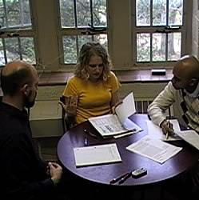
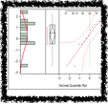
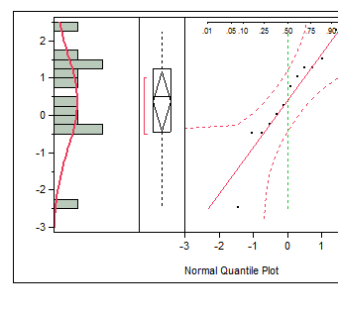
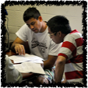
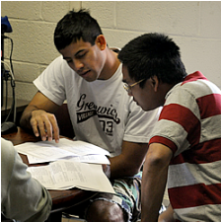


Laboratory for Interdisciplinary Statistical Analysis
LISA helps VT researchers benefit from the use of Statistics
Collaboration:
Visit our website to request personalized statistical advice and assistance with:
Experimental Design • Data Analysis • Interpreting Results Grant Proposals • Software (R, SAS, JMP, SPSS...)
LISA statistical collaborators aim to explain concepts in ways useful for your research.
Great advice right now: Meet with LISA before collecting your data.
LISA also offers:
Educational Short Courses: Designed to help graduate students apply statistics in their research
Walk-In Consulting: M-F 1-3 PM GLC Video Conference Room for questions requiring <30 mins
All services are FREE for VT researchers. We assist with research—not class projects or homework.
www.lisa.stat.vt.edu

Slide 3
Outline
What is R
Why use R
Installing R in your own computer
R studio
Data Structures and Manipulation
Data Import
Exploratory Data Analysis
Loops
If/Else Statements
Data Export
LISA: R Basics
Summer 2013

Slide 4
What is R?
R is a powerful, versatile, and free statistical programming language. Scientists, statisticians, analysts, students and others who are interested in statistical analysis, data visualization, etc. are using R to do so.
Data analysis is done in R by writing or using built in scripts and functions in the R language. The R environment is not only equipped with all the standard methods, but also some of the most recent cutting-edge techniques.
R is open source. This means that you can download and use R for free, and additionally the source code is open and available for inspection and modification.
LISA: R Basics
Summer 2013
LISA: R Basics
Summer 2013

Slide 5
Why use R?
R is free and open.
R is a language. You learn much more than just point and click.
R has excellent tools for graphics and data visualization.
R is flexible. You are not restricted to the built in set of functions, you can use them and extend them with your own.
You can make your analysis your own!
LISA: R Basics
Summer 2013

Slide 6
How to Obtain R for your own computer?
Windows:
http://cran.r-project.org/bin/windows/base/
MacOs X:
http://cran.r-project.org/bin/macosx/
LISA: R Basics
Summer 2013

Slide 7
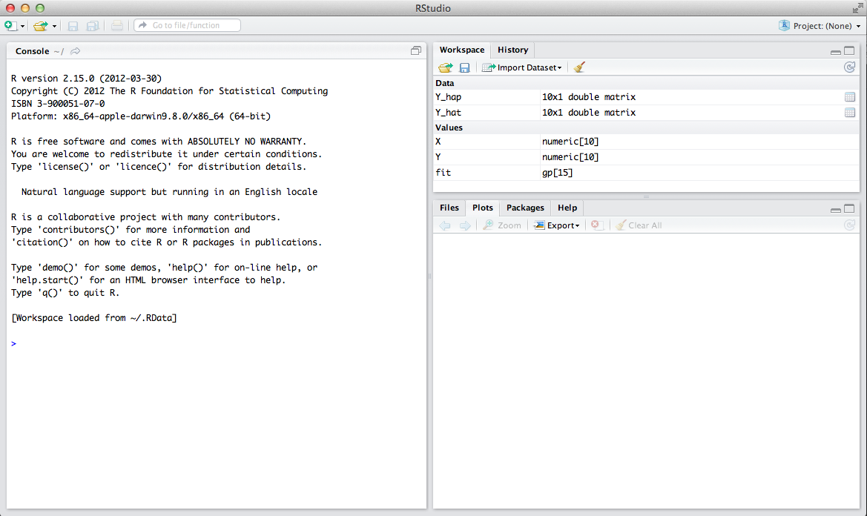
R Studio
Workspace
and history of commands
Available files, generated plots, package management and help
The console will display all your results and commands.
LISA: R Basics
Summer 2013

Slide 8
Help
Point and Click at the interface and search.
Type ??word at the console and R will search for help pages.
Google: How to do in R.
UCLA website: http://www.ats.ucla.edu/stat/
LISA: R Basics
Summer 2013

Slide 9
Data Structures and Manipulation
Object Creation
Expression: A command is given, evaluated and the result is printed on the screen.
Assignment: Storing the results of expressions.
Vectors:
The basic data structure in R. (Scalars are vectors of dimension 1).
Creating sequences:
: command. Creates a sequence incrementing/decrementing by 1
seq() command.
Vectors with no pattern. c() function.
Vectors of characters. Also use c() function with the help of “”
Repeating values. rep() function.
Arithmetic with vectors: All basic operations can be performed with vectors.
Subsets: The basic syntax for subsetting vectors is: vector[index]
LISA: R Basics
Summer 2013

Slide 10
Data Structures and Manipulation
Matrices: Objects in two dimensions.
Creating Matrices
Command: matrix(data, nrow, ncol, byrow).
data: list of elements that will fill the matrix.
nrow, ncol: number of elements in the rows and the columns respectively.
byrow: filling the matrix by row. The default is FALSE.
Some Matrix Functions
dim(): Lists the dimensions of the matrix.
cbind(): Creating matrix by putting columns together.
rbind(): Creating matrix by putting rows together.
diag(d): Creates identity matrix of dimension d.
LISA: R Basics
Summer 2013

Slide 11
Data Structures and Manipulation
Some Matrix computations
Addition
Subtraction
Inverse: function solve()
Transpose: function t()
Element-wise multiplication: *
Matrix multiplication: %*%
Subsets
Referencing a cell: matrix[r,c], where r represents the row and c represents the column.
Referencing a row: matrix[r,]
Referencing a column: matrix[,c]
LISA: R Basics
Summer 2013

Slide 12
Data Import
We need to set the working directory. For this we use the function setwd:
setwd(“location”)
Comma Separated Values:
Use the function read.table
mydatacsv<- read.table('Iris.csv', sep=',', header=T)
Text File:
Use the function read.table:
mydatatxt<- read.table('Iris.txt', sep='\t', header=T)
LISA: R Basics
Summer 2013

Slide 13
Practice 1.
Lets review some of the matrix commands we learned previously by applying them to our new dataset.
What is the dimension of our dataset?
Assign the value of the cell [2,3] to the new variable var1
Assign the value of the cell [10,4] to the new variable var2
Output the value of each column separately.
Assign the values of Petal.Width to a new variable PW.
Output the value of row 15.
LISA: R Basics
Summer 2013

Slide 14
Exploratory Data Analysis: Summaries
Quantitative summary of variable Petal Width. We will calculate the Minimum, maximum, mean, variance, median for that variable.
mean(PW)
var(PW)
min(PW)
max(PW)
median(PW)
You can obtain the 5 number summary for the variable by using the command:
summary(PW)
LISA: R Basics
Summer 2013

Slide 15
Exploratory Data Analysis: Graphs
Histogram of PW.
hist(PW, main="Histogram of Petal Width", col="dodgerblue", breaks=10)
Boxplot of PW
boxplot(PW, main="Boxplot of Petal Width", col="khaki1", ylab="Petal Width”)
Boxplot of PW by Species.
boxplot(PW~mydatacsv[,5])
Normal Quantile-Quantile Plot
qqnorm(PW, main="Normal QQ Plot Petal Length")
http://www.stat.columbia.edu/~tzheng/files/Rcolor.pdf
LISA: R Basics
Summer 2013

Slide 16
For Loops
This statement allows for code to be executed repeatedly.
for(i in 1:n){
statement
}
LISA: R Basics
Summer 2013

Slide 17
While Loops
This statement allows for code to be executed repeatedly while a condition holds true.
while(condition){
statement
}
LISA: R Basics
Summer 2013

Slide 18
If/Else Statement
if statement - use this statement to execute some code only if a specified condition is true:
if(condition){ statement }
LISA: R Basics
Summer 2013

Slide 19
If/Else Statement
if...else statement - use this statement to execute some code if the condition is true and another code if the condition is false.
if ( condition )
statement
else
statement2
LISA: R Basics
Summer 2013

Slide 20
If/Else Statement
if...else if....else statement - use this statement to select one of many blocks of code to be executed
if (condition){
statement
} else{
if (condition2){
statement2
} else {
Statement4
}
}
LISA: R Basics
Summer 2013

Slide 21
Data Export: csv
If you have modified your dataset in R you can export it as a .csv file using the following code:
write.csv(mydatacsv,file="mydatacsv.csv")
Can also export vectors or other objects that you have created to .csv file:
write.csv(vec2,file="vec2.csv")
LISA: R Basics
Summer 2013

Slide 22
Data Export: txt
If you have modified your dataset in R you can export it as a space delimited .txt file using the following code:
write.table(mydatacsv,file="mydatatxt.txt", sep=" ")
You can export it as a tab delimited .txt file using the following code:
write.table(mydatacsv,file="mydatatxt2.txt", sep="\t")
LISA: R Basics
Summer 2013

Slide 23
National Longitudinal Mortality Study Dataset
The variable content for each record on the file includes demographic and socioeconomic variables from the Current Population Survey combined with the underlying cause of death mortality outcome and the follow-up time until death for records of the deceased or 11 years of follow-up for those not deceased.
The previous information was taken from the reference manual of the dataset, this manual and a complete variable description is attached in the course materials.
LISA: R Basics
Summer 2013

Slide 24
Practice 2 a.
Read into R the dataset pubfileb.csv.
Determine the dimensions of the dataset.
Extract the variable povpct, income as percent of poverty level (column 35) as a new variable.
Extract the variable ms, marital status (column 5) as a new variable.
Obtain the minimum, maximum, mean, variance, median for the variable povpct and store them in separate variables.
Create a vector with the stored values from 5.
Create a histogram of povpct of a different color with 20 breaks.
LISA: R Basics
Summer 2013

Slide 25
Practice 2 b.
Create a boxplot of povpct of a different color.
Create a boxplot of povpct by ms with the same color for all boxes.
Create a boxplot of povpct by ms with the same color for the first three boxes and another color for the remaining three boxes.
Create a normal Q-Q plot for povpct.
Using for loops count how many observations are there in a metropolitan area (smsast=1) (col 20) with an age lower than 15 (col 2).
Export your extracted variables as a .csv file and the dataset as a tab delimited .txt file.
LISA: R Basics
Summer 2013

Slide 26
Please don’t forget to fill the sign in sheet and to complete the survey that will be sent to you by email.
Thank you!
LISA: R Basics
Summer 2013

